Slide 1

Medical Trace Portal
An Apple a Day Keeps the Doctor Away

Slide 2
Contents
About Us
Problem Statement
Problem Analysis
Architecture Design
Demonstration

Slide 3
1. About Us
Long
Backend developer for Form/Statistic model.
Develop controller for Citizen and HO (Health Organization).
Design Database schema. Develop controller for Base, Authorization and Citizen.
Implement MVC/database and PDO.
Implement session, hashing and routing.

Slide 4
1. About Us
Tung
Frontend developer.
Design views.
Handle asset and scripts.
Implement htmlencode.

Slide 5
1. About Us
Hieu Do
UI/UX designer and Mockup creator.
Implement HO form and HO statistics views.
Design architecture: MVC and DAO.
Design ER, Usecase, Communication and Class diagram.
Documentation: Slide.

Slide 6
1. About Us
Hieu Bui
Backend developer for Account/Citizen/HO model.
Develop controller for Base, Authorization and Citizen.
Implement MVC/database and PDO.
Implement session, hashing and routing.

Slide 7
2. Problem
This website allows users to fill their own daily medical declaration form and specific forms of Health Organizations.
In one hand, the information provided by users helps Health Organization to
know the patient status in large number without unnecessary movements and hospital overcrowding,
and control situations and prevent diseases, especially in pandemic time.
On the other hand, the users get
medical information directly from authority in a fast-effortless way,
and help to build a safer community.

Slide 8
3. Problem Analysis
Usecase diagram
Notes:
Usecase

Slide 9
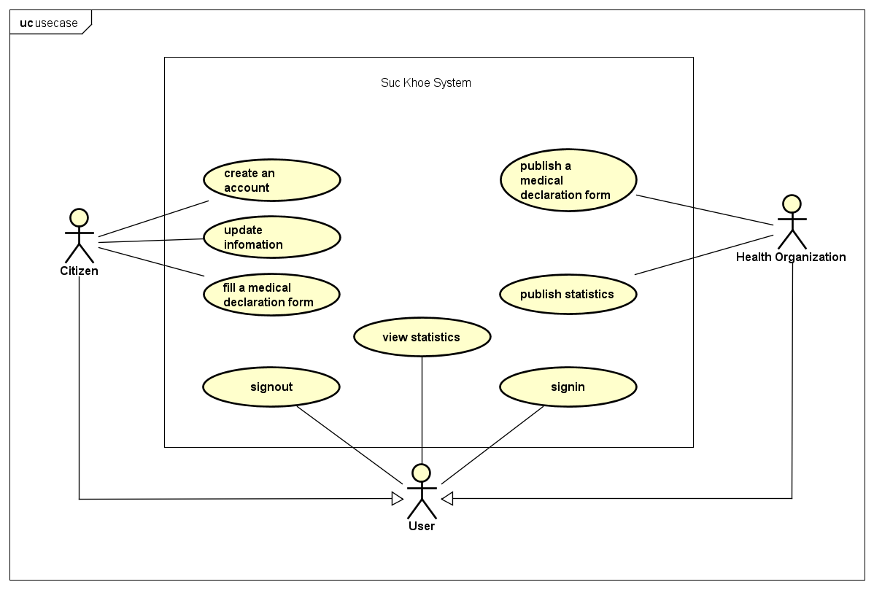

Slide 10
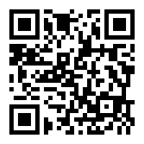
4. Design
4.0. UX/UI Design:
Please see:
https://www.figma.com/files/project/7965019/SUCKHOE
Notes:
Communication Diagram
Class Diagram

Slide 11
4. Design
4.1. Entity-relationship model
Notes:
Communication Diagram
Class Diagram

Slide 12
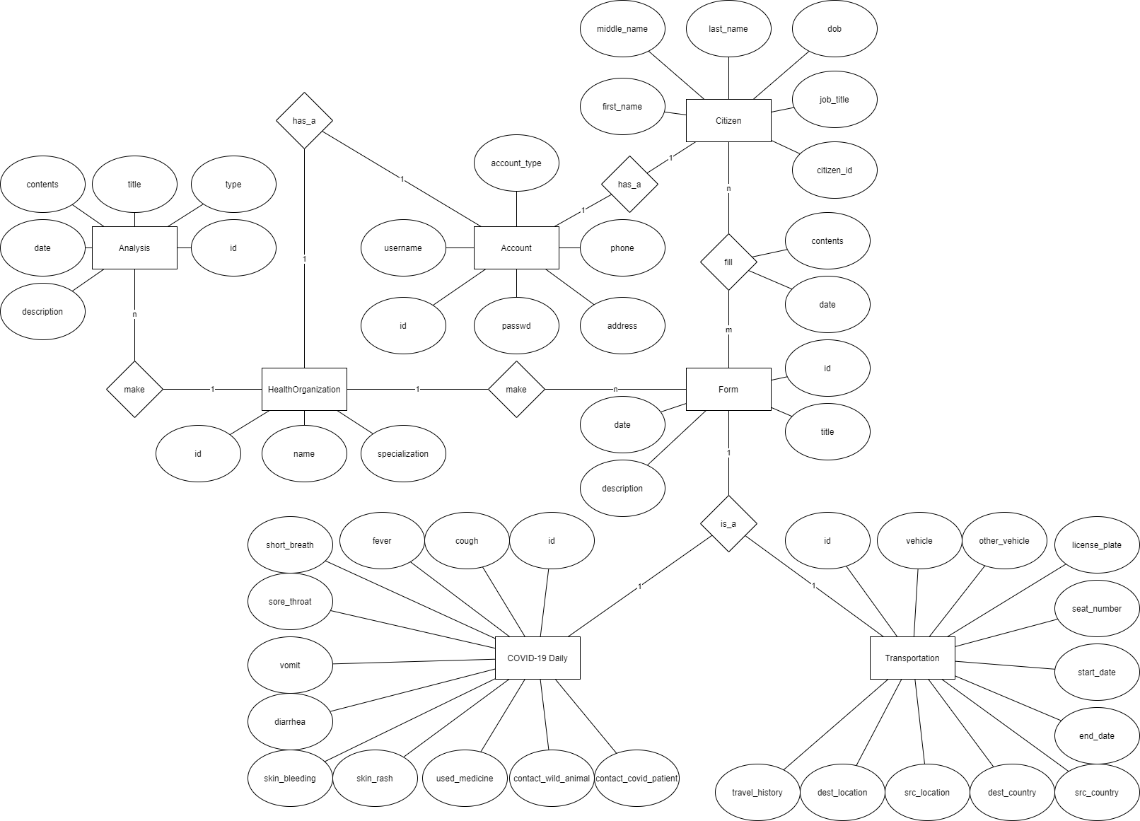

Slide 13
4. Architecture Design
4.2. Database Schema
Notes:
Communication Diagram
Class Diagram

Slide 14
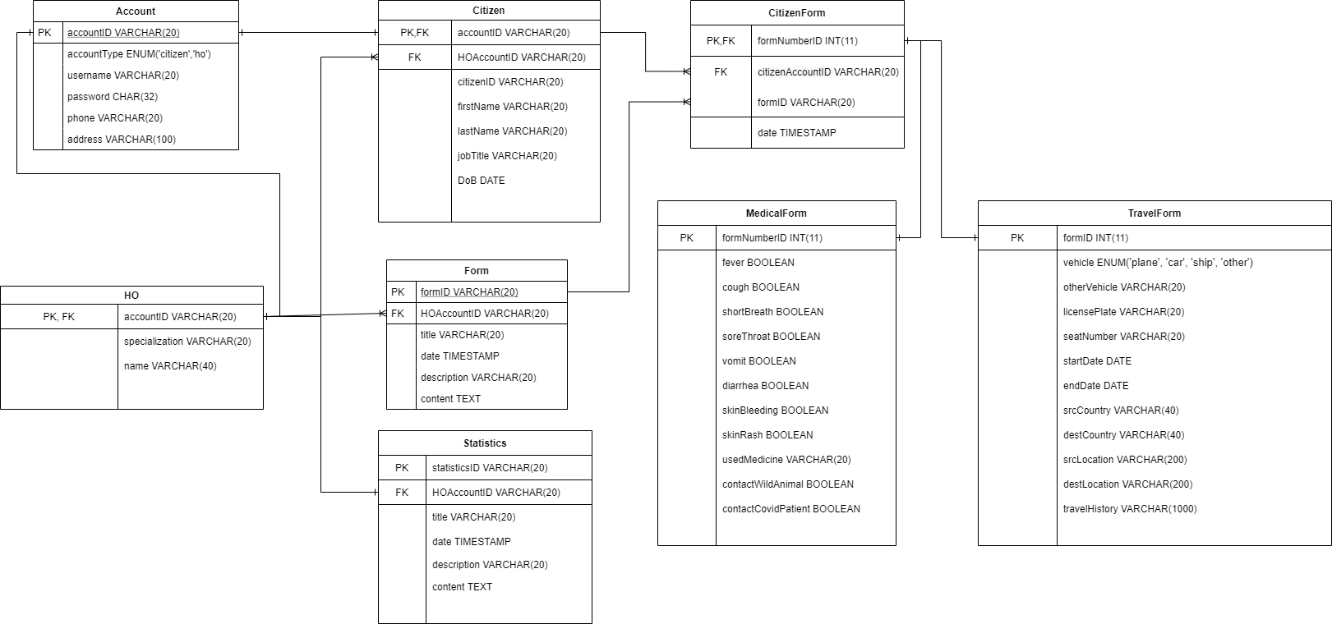
Notes:
Communication Diagram
Class Diagram

Slide 15
4. Architecture Design
4.3. Unified Class Diagram

Slide 16
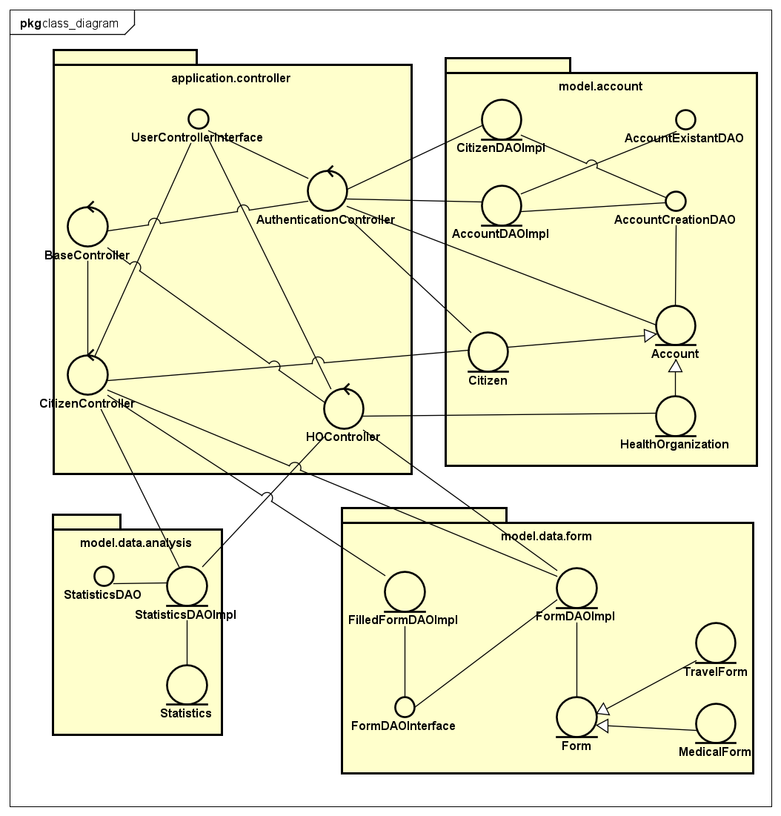

Slide 17
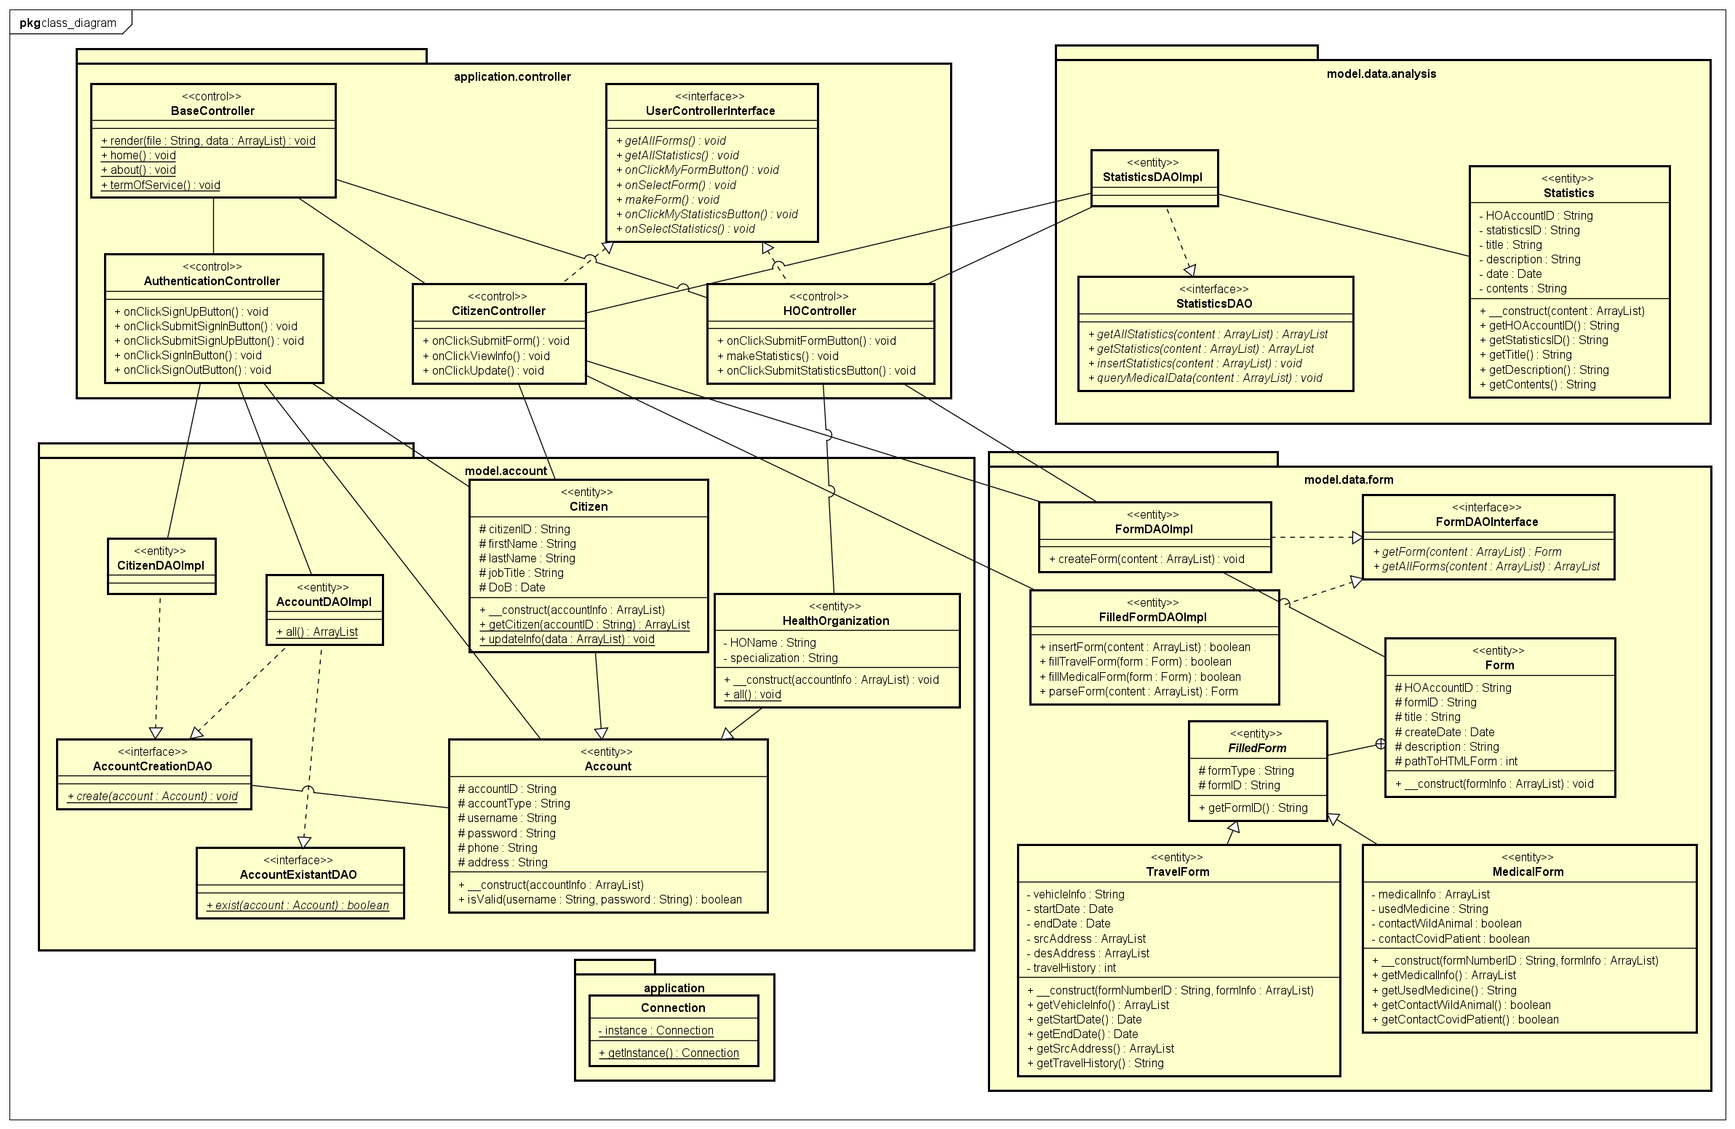

Slide 18
5. Demonstration

Slide 19
Thanks for Your Listening
Q&A

